Slide 1

ADVANCED
PROGRAMMING WITH
PYTHON
Pros: Tran Giang Son
Group 18’s members:
* Nguyen Đuc Thang
* Le Duc Manh
* Tran Dung
* Dam Than Long

Slide 2
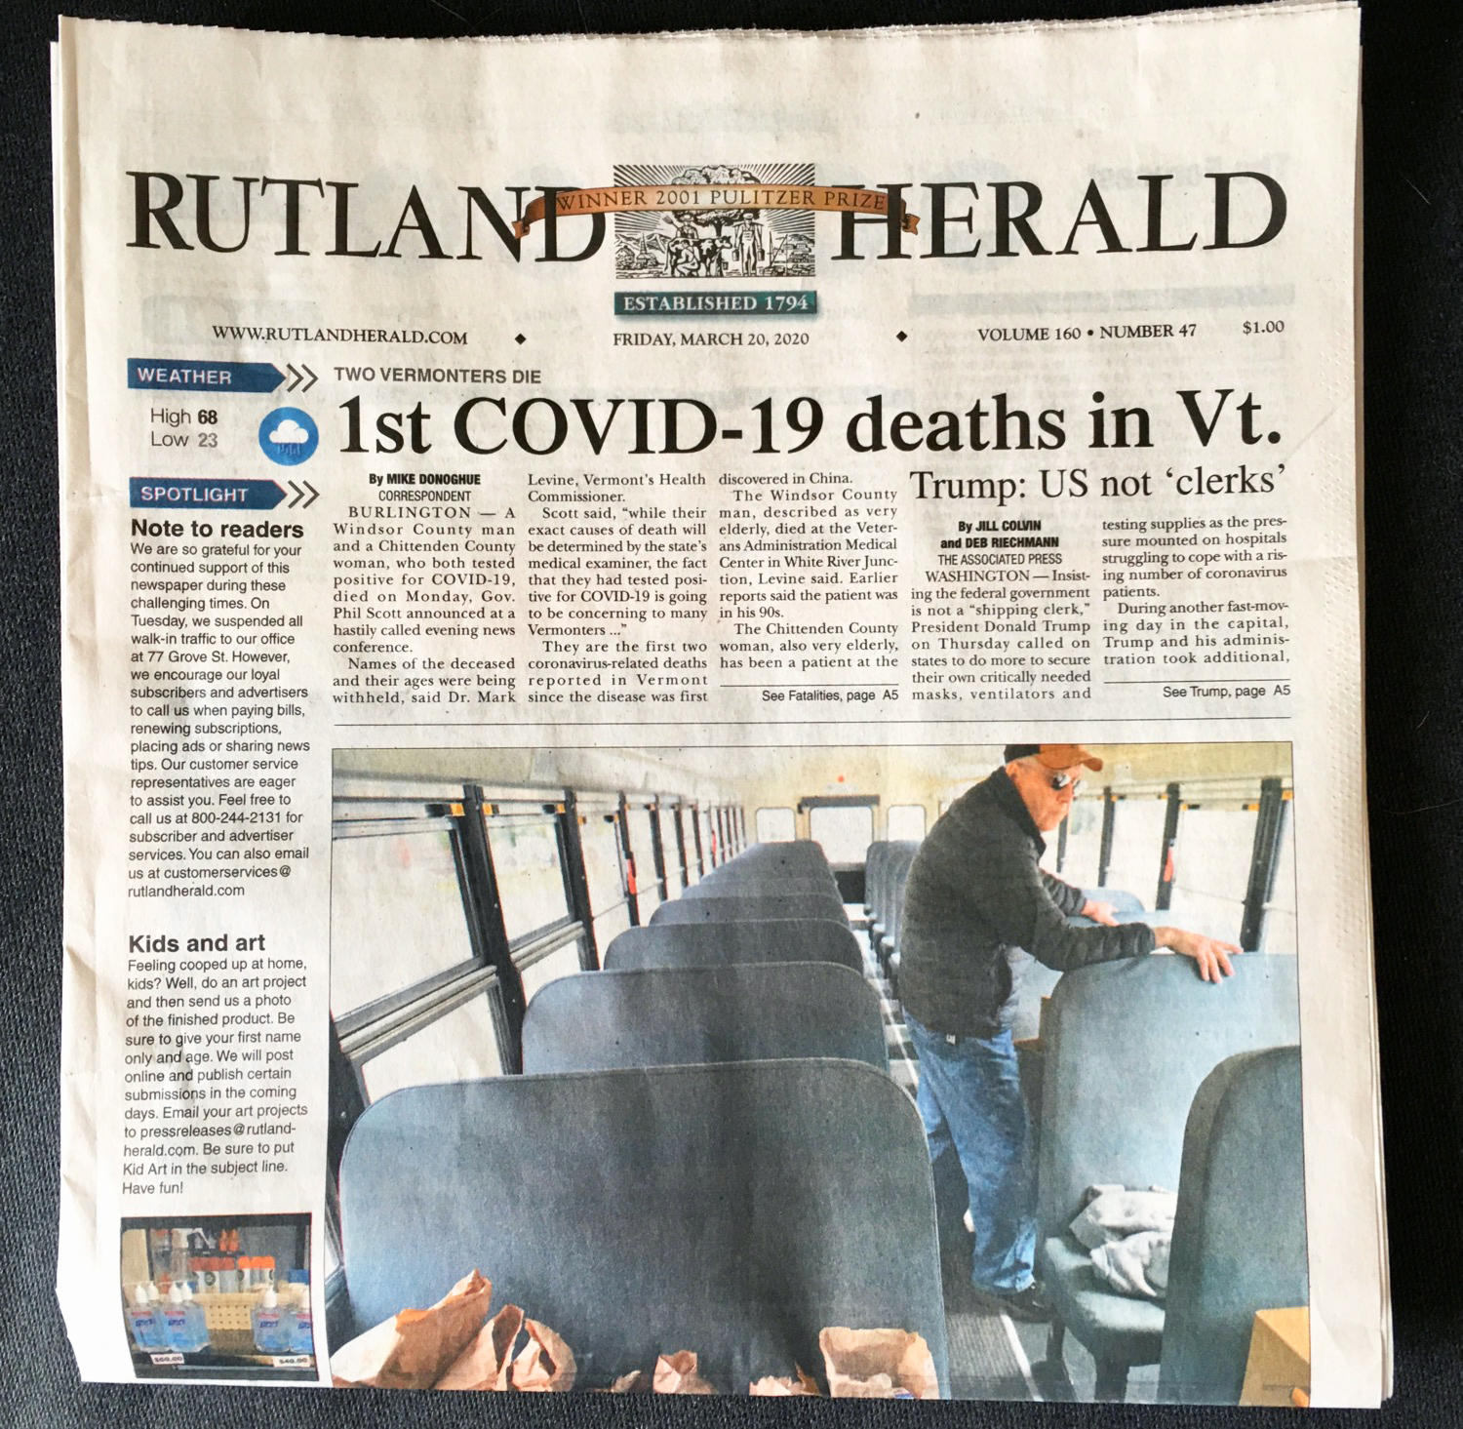

Topic 12: Newspapers Information Management System

Slide 3
INTRODUCTION
01
STRUCTURE
02
TABLE OF CONTENTS
03
DEMO
04
CONCLUSION
What?
Why?
Database diagram
Modules
Packages

Slide 4
01
INTRODUCTION

Slide 5
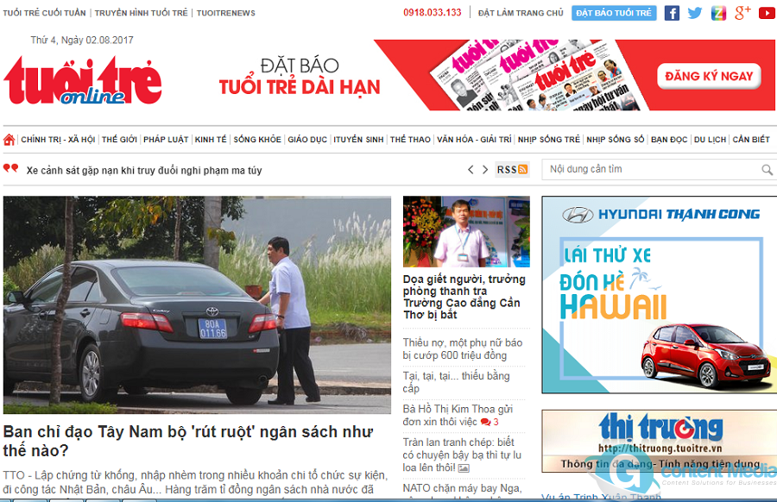
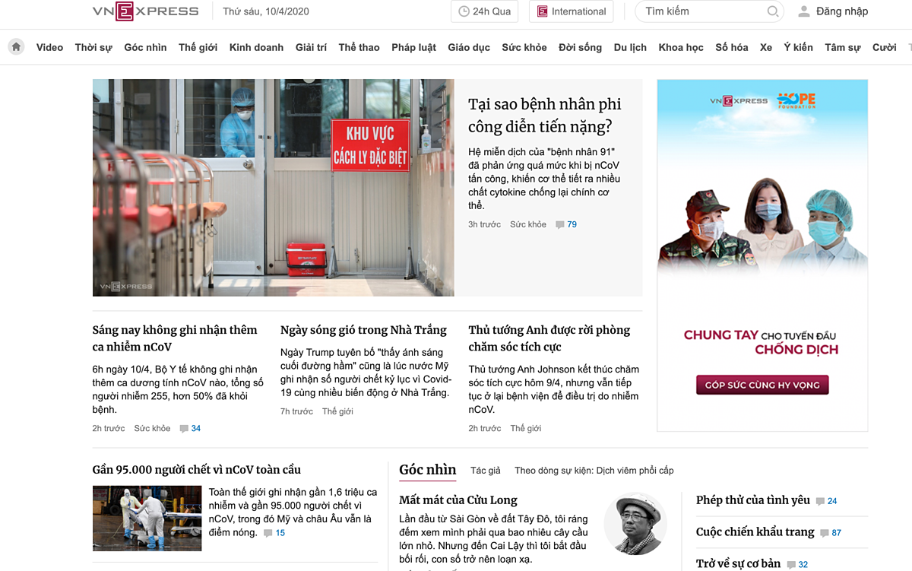
PLATFORMS

Slide 6

WHAT?
*) Definition:
Information is not knowledge, knowledge is one kind of structured representation of information.
A system that was built using knowledge about programming language (Python) to create functions, methods, packages,…
Overall, we create a program where you can manage information about the ongoing events worldwide with interesting title such as: President Donald Trump had been found a part of corruption at Las Vegas, Tony Stark is actually alive?, etc.

Slide 7
WHY?
*) For Admin:
- This system can be good replacer for hectic manual technique of newspaper distribution.
- This system helps to distribute newspaper online.
- An easy to use and easy to manage operating system for your newspaper database.
- Being able to constantly edit and adding news online without any troubles.
*) For Users:
- Simple platform where you can read all the daily news of your choice.
- Easily find appropriate content.
- Maybe distinguish between fake news and original news.
- Receive more useful knowledge.

Slide 8
02
STRUCTURE

Slide 9
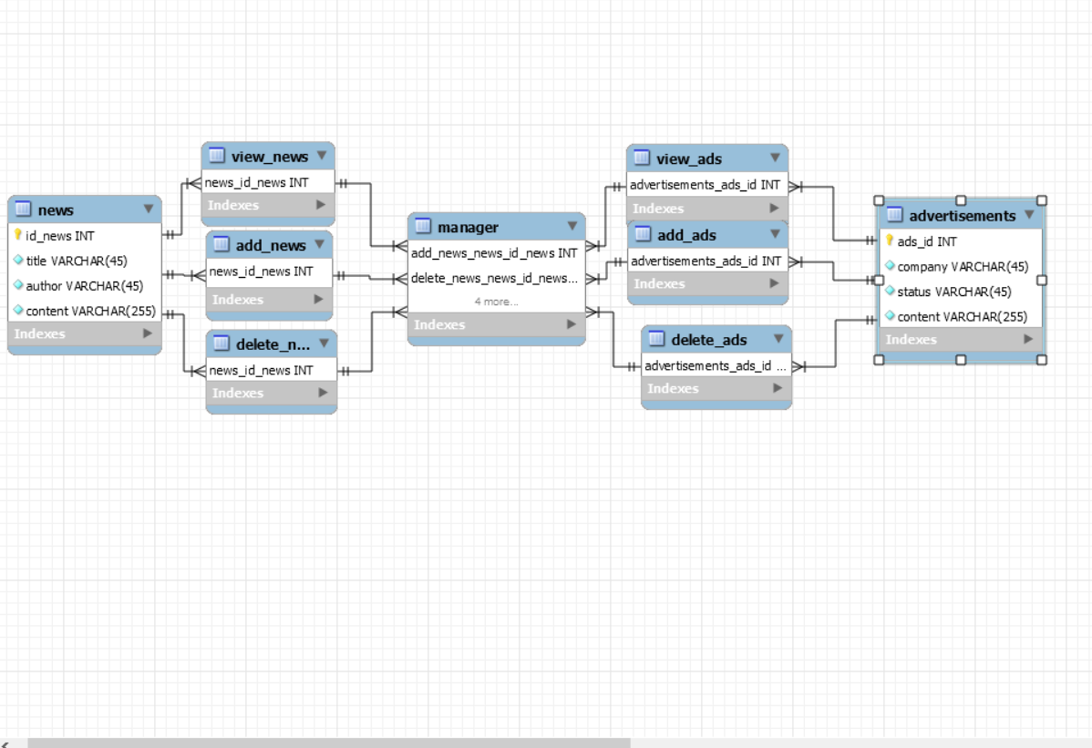
DATABASE DIAGRAM

Slide 10
MODULES
News and advertises are published in newspaper. Our system comprises of 3 major modules with their sub-modules:
main.py
News: AddNewspaper.py, DelsNewspaper.py, ViewNewspaper.py.
Advertisements: AddAds.py, DelAds.py, ViewAds.py.

Slide 11
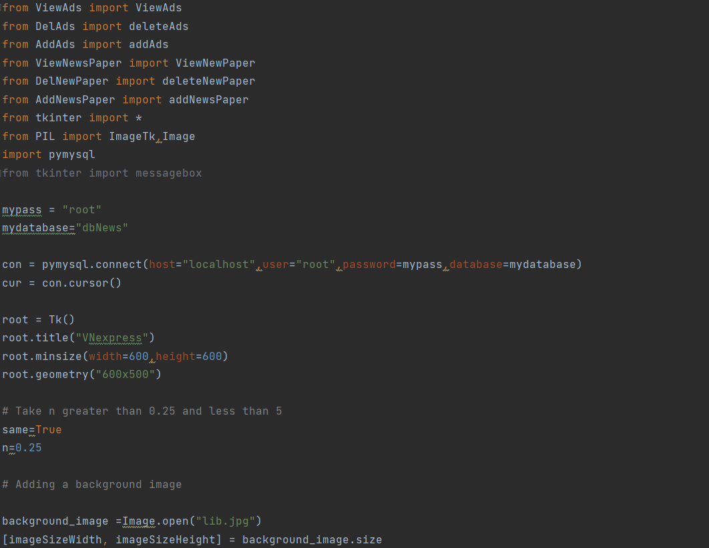
main.py

Slide 12
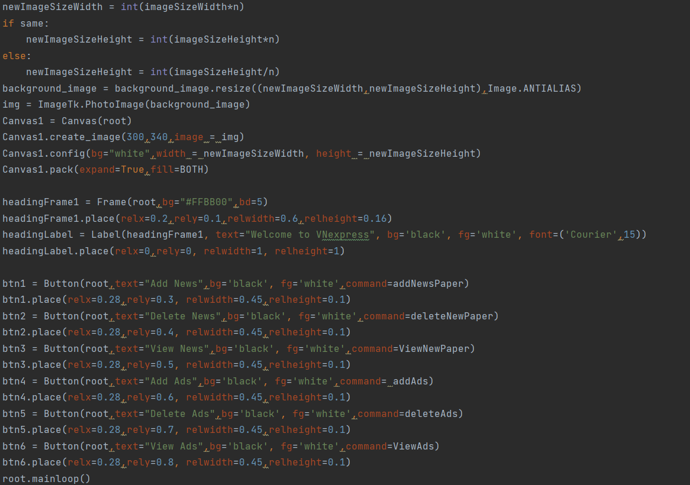

Slide 13
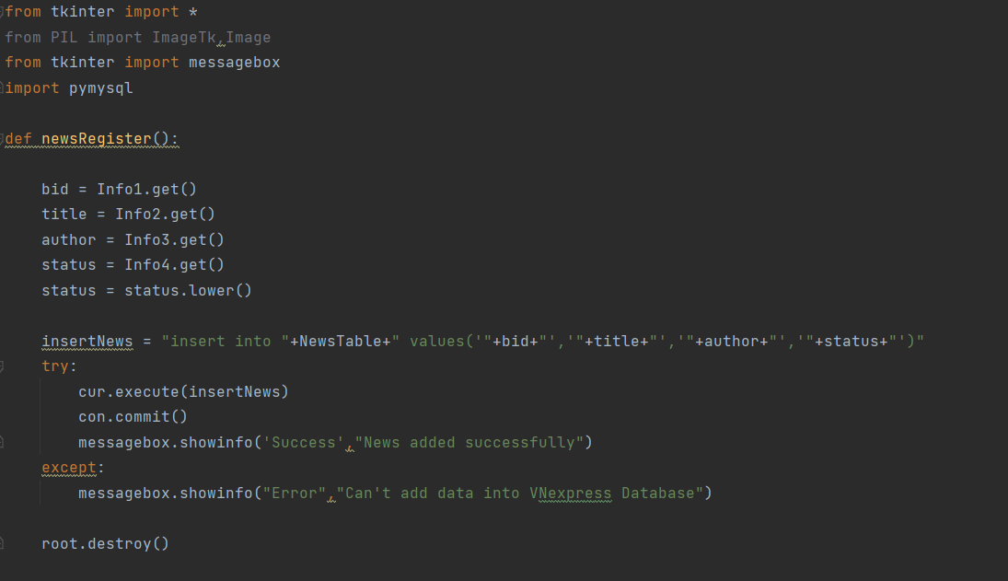
AddNewspaper.py

Slide 14
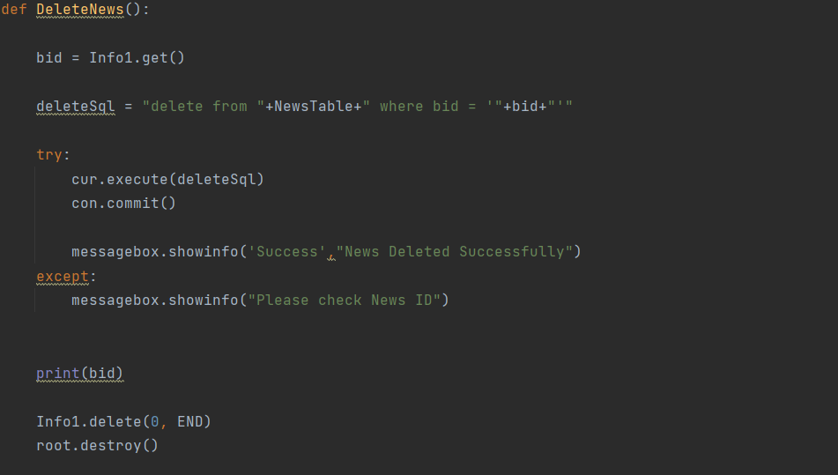
DelNewspaper.py

Slide 15
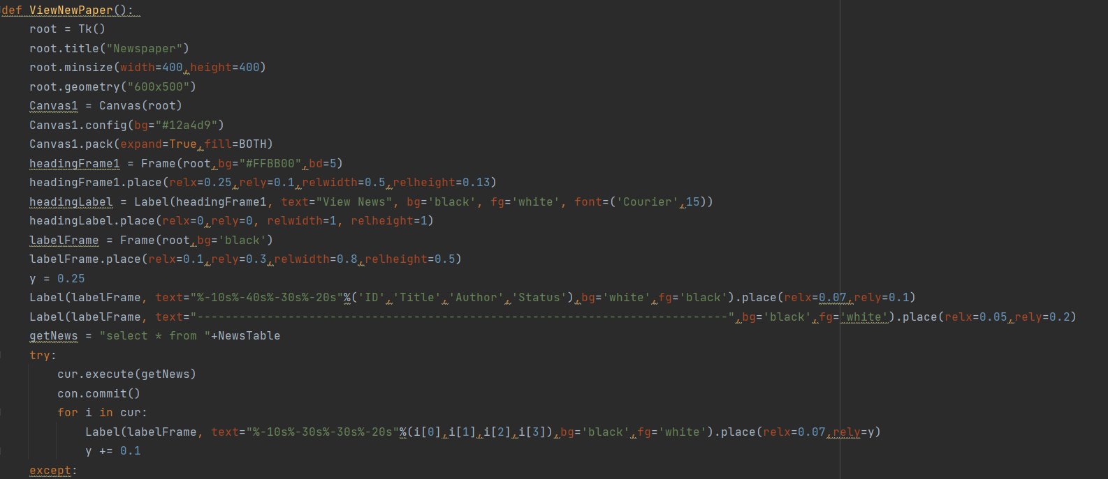
ViewNewspaper.py

Slide 16
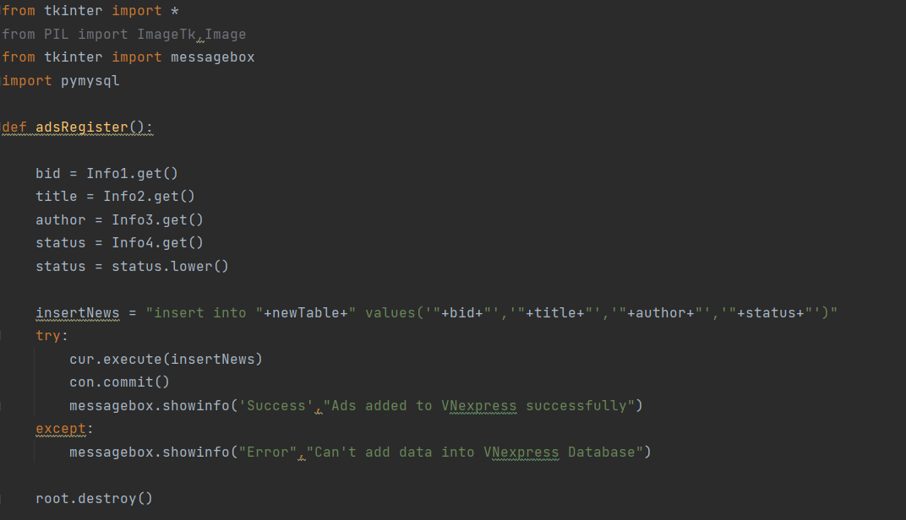
AddAds.py

Slide 17
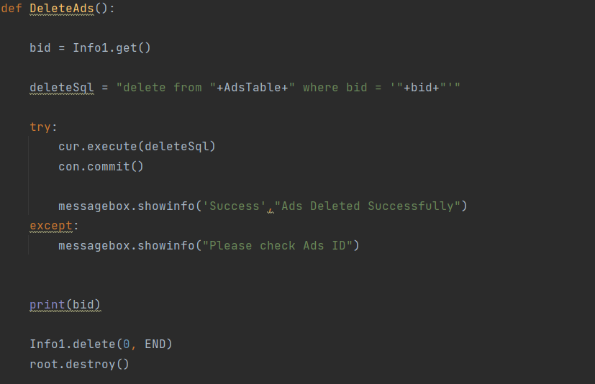
DelAds.py

Slide 18
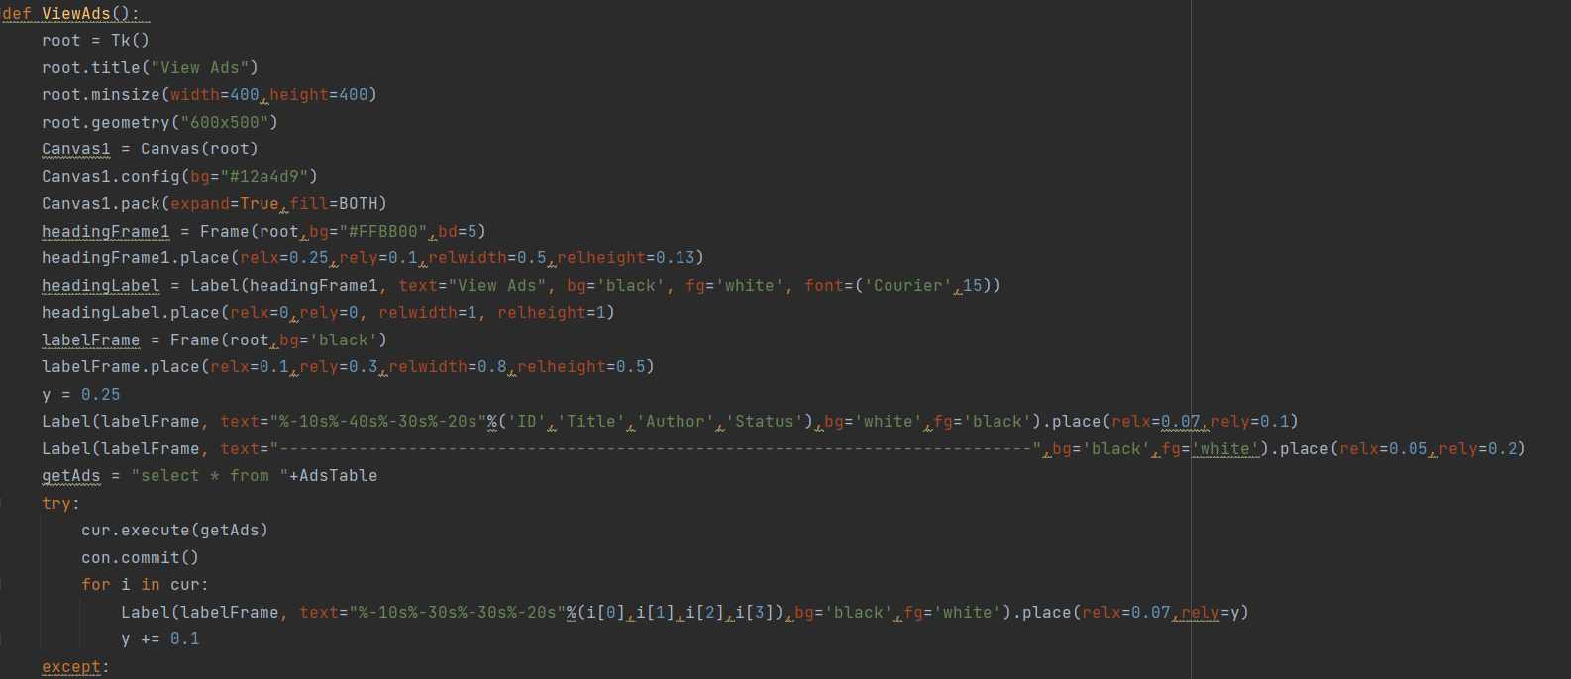
ViewAds.py

Slide 19
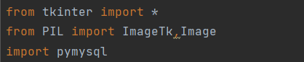
PACKAGES
tkinter: Packages which made UI
PIL: Image Processing
pymysql: Link python with mysql
new employees last semester

Slide 20
03
DEMO

Slide 21
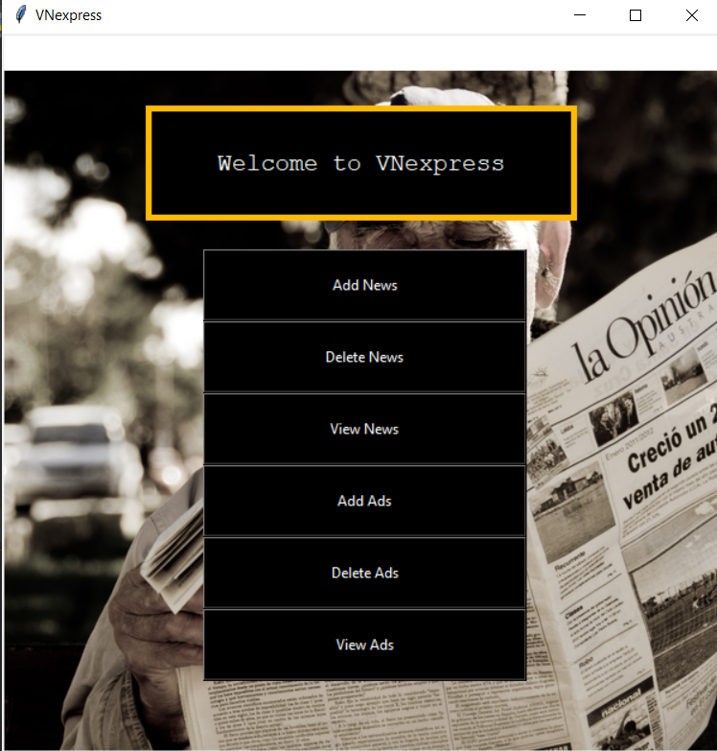

Slide 22
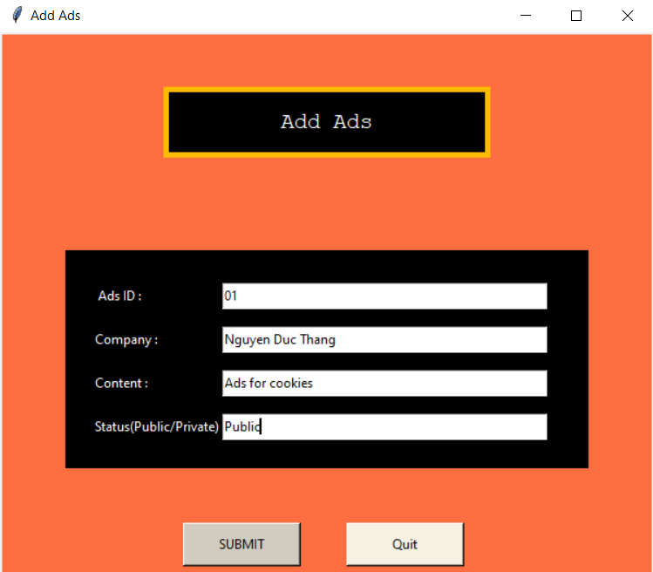
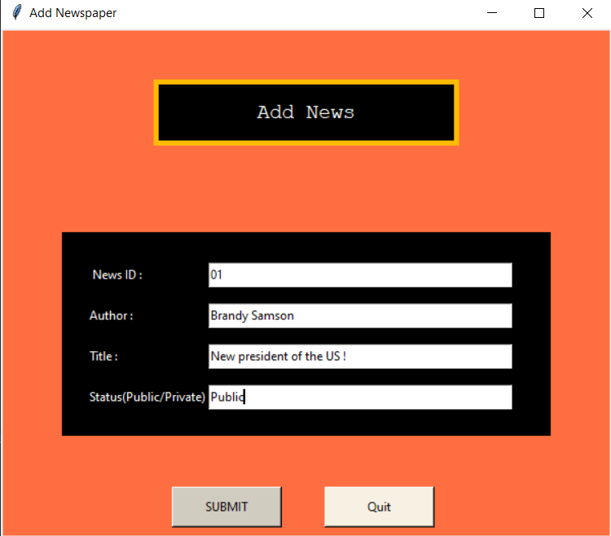

Slide 23
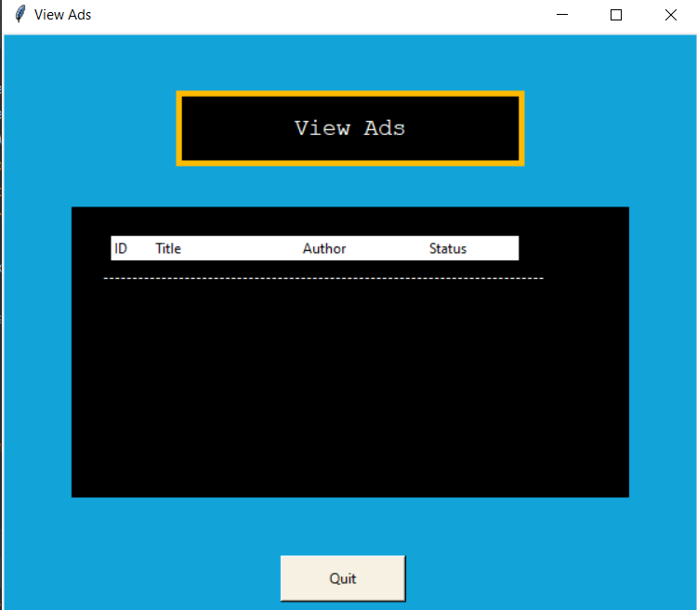
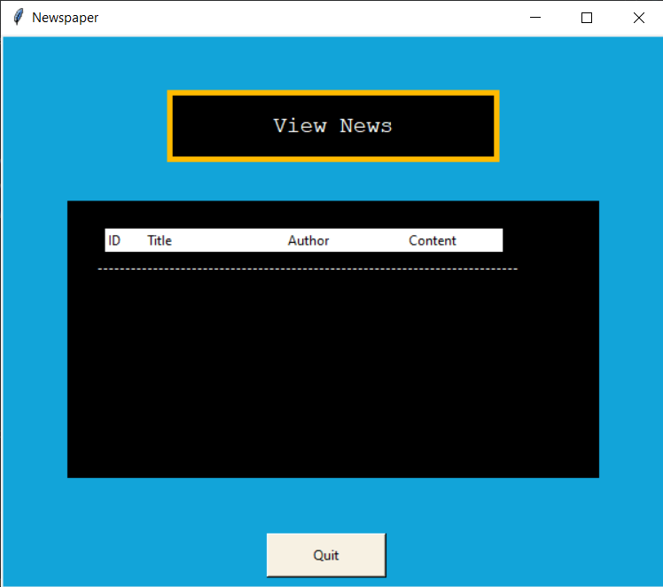

Slide 24
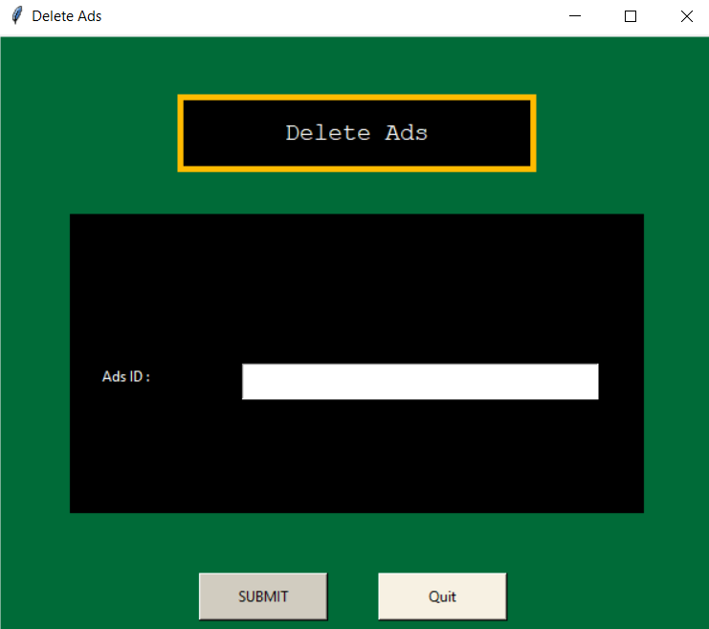
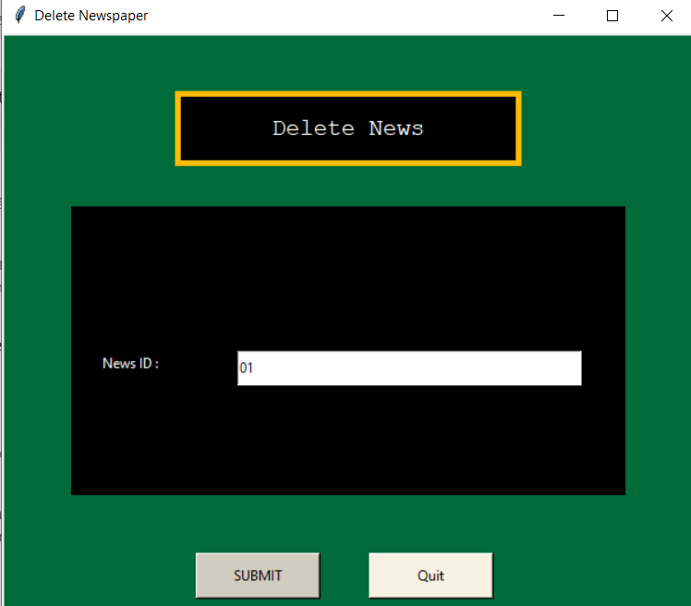

Slide 25
04
CONCLUSION
The Newspaper Information Management System Project has finally been finished, and from it we have learned a few things:
Basic concepts about Advanced Programming with Python.
Skills and knowledge from Basic Database.
Modules, packages,…

Slide 26
Thanks for listening ☺

